Slide 1
Notes on layout, Graphics & Fonts
This template is intended to help minimize the work of creating lesson plans on setting-specific behavior expectations.
Fonts and layout:
Red highlighting indicates a place for information to be inserted: your school name, the setting relevant to the lesson, or your school expectations.
On some slides, a box indicates to insert material from your school’s implementation manual.
This document uses the two default fonts on MS-Word (Cambria for headings, and Calibri for body text). This should make it easier to copy and paste from your school’s implementation manual or from other MS-Word documents.
The chalkboard “background” can be altered or hidden by editing the background graphics on the master slide (VIEW > SLIDE MASTER).
Graphics and clip art may be used to create an age appropriate lesson
Please feel free to adjust these settings to your school’s own style – this document is just to help your school staff get started.
Sincerely,
The CI3T Team

Slide 2
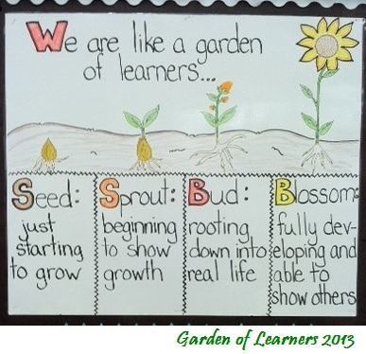
Demonstrating our Expectations in the
School Garden

Slide 3
Our Three School Expectations
Students will be respectful of garden life and people
Students will use their observation skills

Slide 4
Today we’re going to talk about ways you can show EXPECTATIONS 1 and 2 in the Garden

Slide 5
What are some things that happen in the Garden that cause problems for you and others?
How do you usually react in these situations?
What are some good ways to act in order to keep these things from happening?

Slide 6
What does being respectful of garden life and people mean?
Show video to explain garden rules and expectations.
https://www.youtube.com/watch?v=5EmCJGaO3xE

Slide 7
Garden Rules
o Walk in the garden
o Feet on the paths, not on the beds
o Use tools correctly and responsibly
o Always ask before picking or eating anything
o Be respectful of garden life and people

Slide 8
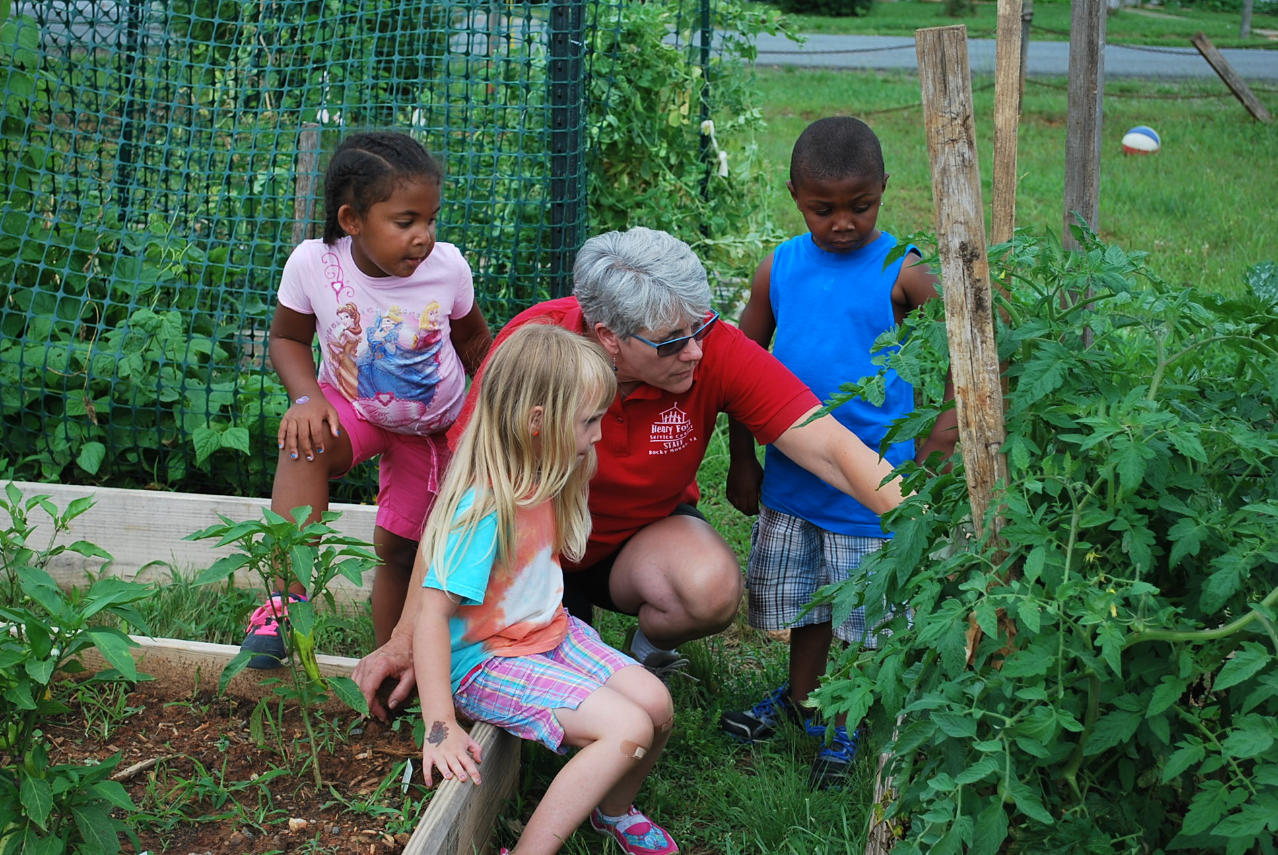
What does using your observation skills in the garden mean?
Students having a deeper understanding of observation and using your senses.

Slide 9
Role Play!
You are on the playground after school playing with your friends and you decide to go into the garden. A friend says I dare you to pull out those plants. What do you do?

Slide 10
Review
What are the expectations for being respectful of garden life and people ?
Why is it important to use your observation skills in the garden?

